Slide 1




Liceo «N. Machiavelli» High School
www.liceomachiavelli-firenze.edu.it
via Santo Spirito, 39 – 50125 Firenze
tel. 055-2396302 - fax 055-219178
e-mail: liceomachiavelli.firenze@gmail.com -
PEC: fiis00100r@pec.istruzione.it

Slide 2

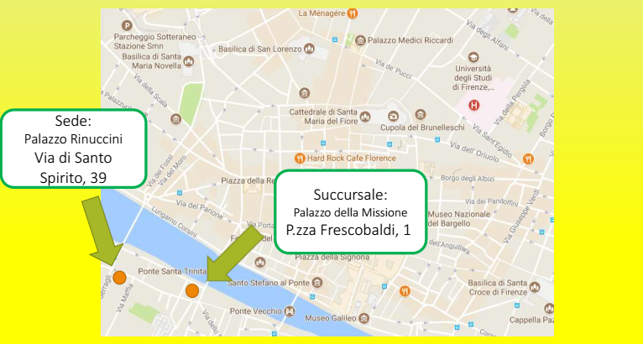
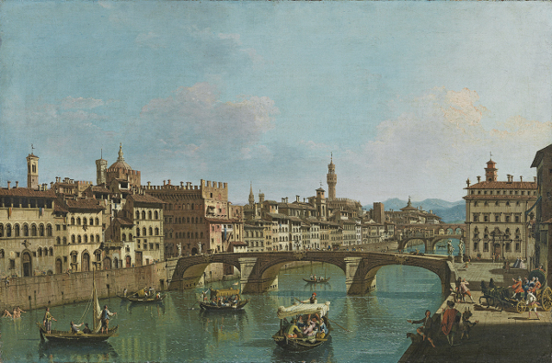
Two locations
65 classes
1600 students
165 teachers

Slide 3
Paths of Study
Classical Lyceum
Human Sciences Lyceum
Social Economics Lyceum
Scientific International Lyceum
Foreign Languages International Lyceum

Slide 4
Classical Lyceum
The Classical Lyceum, open to innovative methodological approaches, combines the rigor of the philological method, typical of the classical disciplines, with the vivacity of cultural interests. Numerous integrative activities aimed at underlining the unity of knowledge in the perspective of a comprehensive and complete student education.
Classical Theater Laboratory
Art History project, in Palazzo “RinuccinI”
HERMES, the Lyceum magazine
Musical project
Project of Classical Law and Economics
Teaching with CLIL methodology: History of art in English

Slide 5
Human Sciences Lyceum
The Lyceum of Human Sciences deepens the high school culture from the point of view of the knowledge of the phenomena connected to the construction of personal identity and of human and social relations.
It proposes:
a considerable number of hours for teaching human sciences and similar discipline;
study of the Right to biennium;
study of a foreign language (English) for the entire five-year period;
study of the History of Art in the three-year period.
The mathematical-scientific axis is well represented, with the teaching of Mathematics, Physics and Natural Sciences

Slide 6
Social Economic Lyceum
The Social Economic Lyceum provides students with advanced skills in the studies related to the human, juridical, economic and social sciences, useful for understanding the dynamics of economic and social reality with particular reference to the world of work and business.
This lyceum is characterized by an innovative system that includes:
the teaching of human sciences in close connection with law and economics;
the teaching of mathematics as a fundamental tool for the measurement of phenomena;
the teaching of two foreign languages (English and French) for the entire five-year period.

Slide 7

International Lyceum
The International Lyceum was established in 1989 on the basis of the bilateral agreements between Italy and France.
Since 2011, all the final classes of the International Lyceum support the EsaBac, the exam that issues the both degree, Italian and French.

Slide 8
International Lyceum
Scientific address
Same first & second year
Third language:
Spanish
Linguistic address
Third language: German

Slide 9

Confucius Classroom
Since 2009 at the “Machiavelli” High School a Confucius Classroom is active, within which are organized:
Chinese language courses from the 1st to the 4th level
Two weeks' stay in China at the beginning of each school year
Since 2013, the High School has officially been home to cultural events related to Chinese culture.

Slide 10
Experience in other projects
Erasmus+ KA1 "Una scuola per tutti, una scuola europea", students mobility.
Erasmus+ KA2 “Europa ti vedo ti vivo”, teachers learning.
Erasmus+ KA2 "Goerudio", promotion of scientific knowledge at all level of education by implementing innovative strategies.
Erasmus+ KA “Do Well Science”, promotion of scientific knowledge by web portal and app, at high school level.
Erasmus+ KA2 “SMiLD”, Focus on Students with Mathematics Learning Disabilities.
NCSSM: North Caroline School of Mathematics and Science to interchange the experiences and methodologies of science teaching.

Slide 11
“Machiavelli” and Do Well Science
The "Machiavelli" high school will be responsible for project management, organization, implementation of the intellectual outputs, evaluation of quality issues and evaluation, dissemination and exploitation of the IOs.
The ultimate goal is to help students permanently solve some of the classic difficulties encountered in mathematics, physics and sciences.

Slide 12
Liceo «N. Machiavelli»
Thank you for the attention
Florence, 28 nov 2018
Massimo Amato

